Slide 1
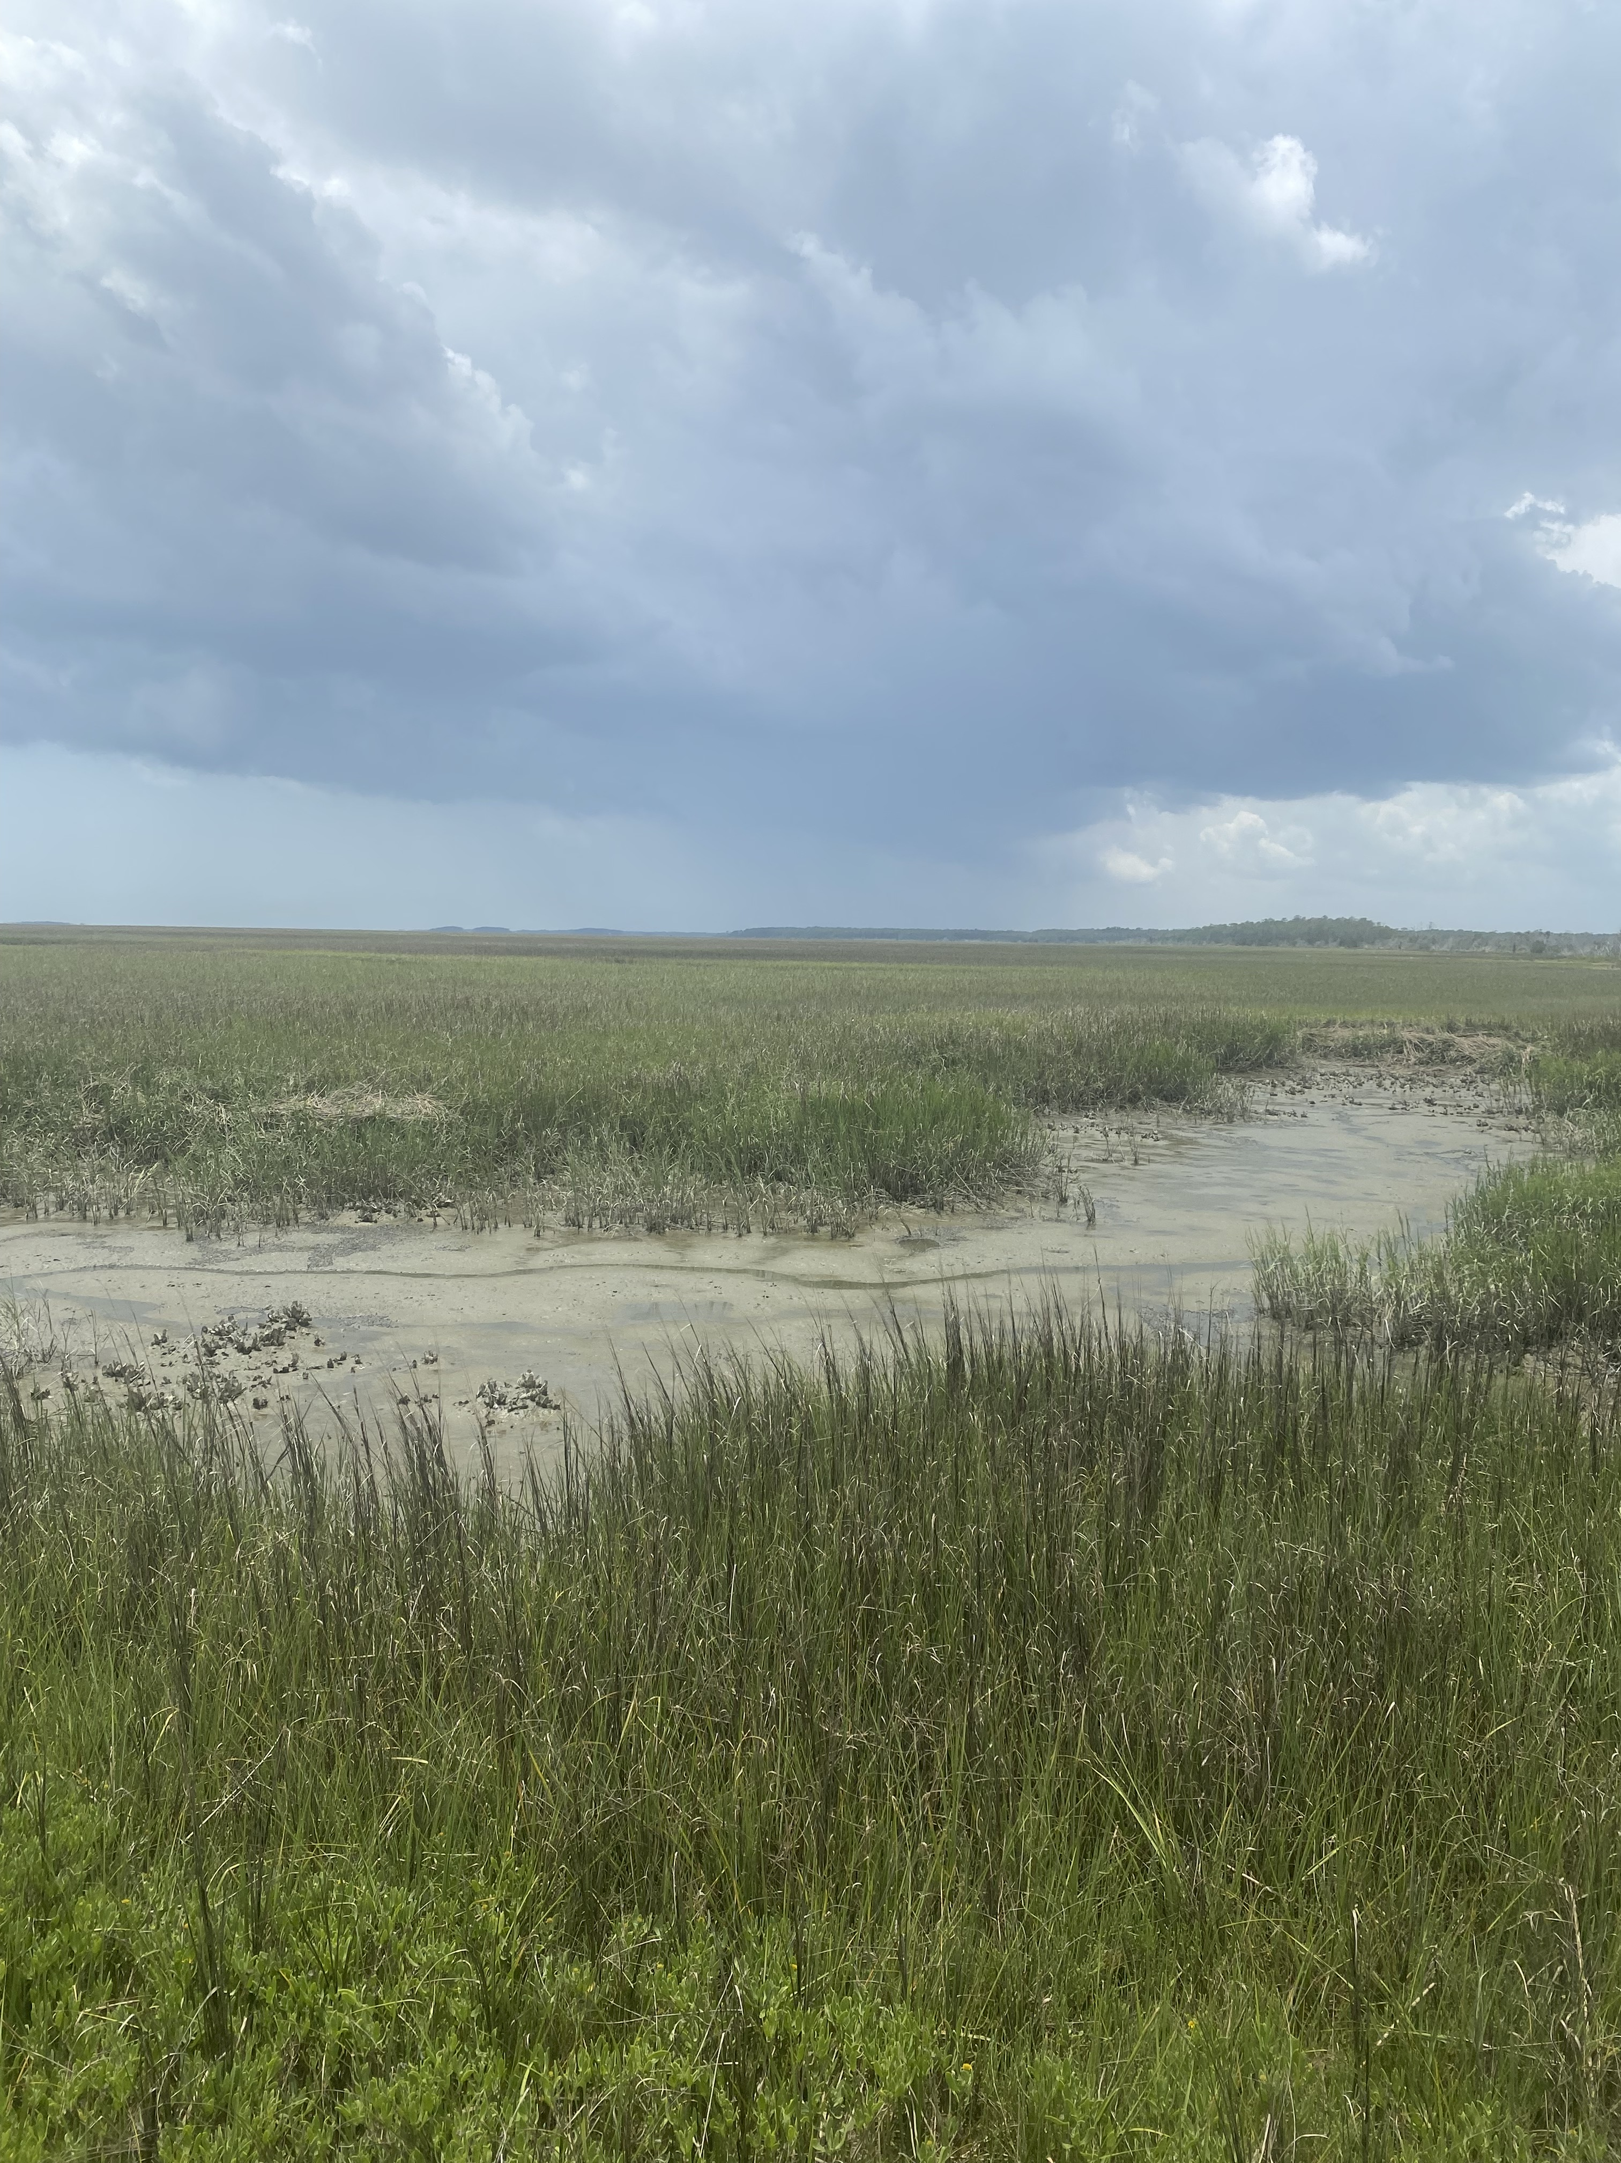




ABIOTIC DETERMINANTS OF INTERTIDAL BENTHIC MICROALGAL BIOMASS IN ESTUARINE ECOSYSTEMS
Henry Guy
Dr. Jay Pinckney
Estuarine Ecology Lab
University of South Carolina
School of the Earth, Ocean, and the Environment

Slide 2
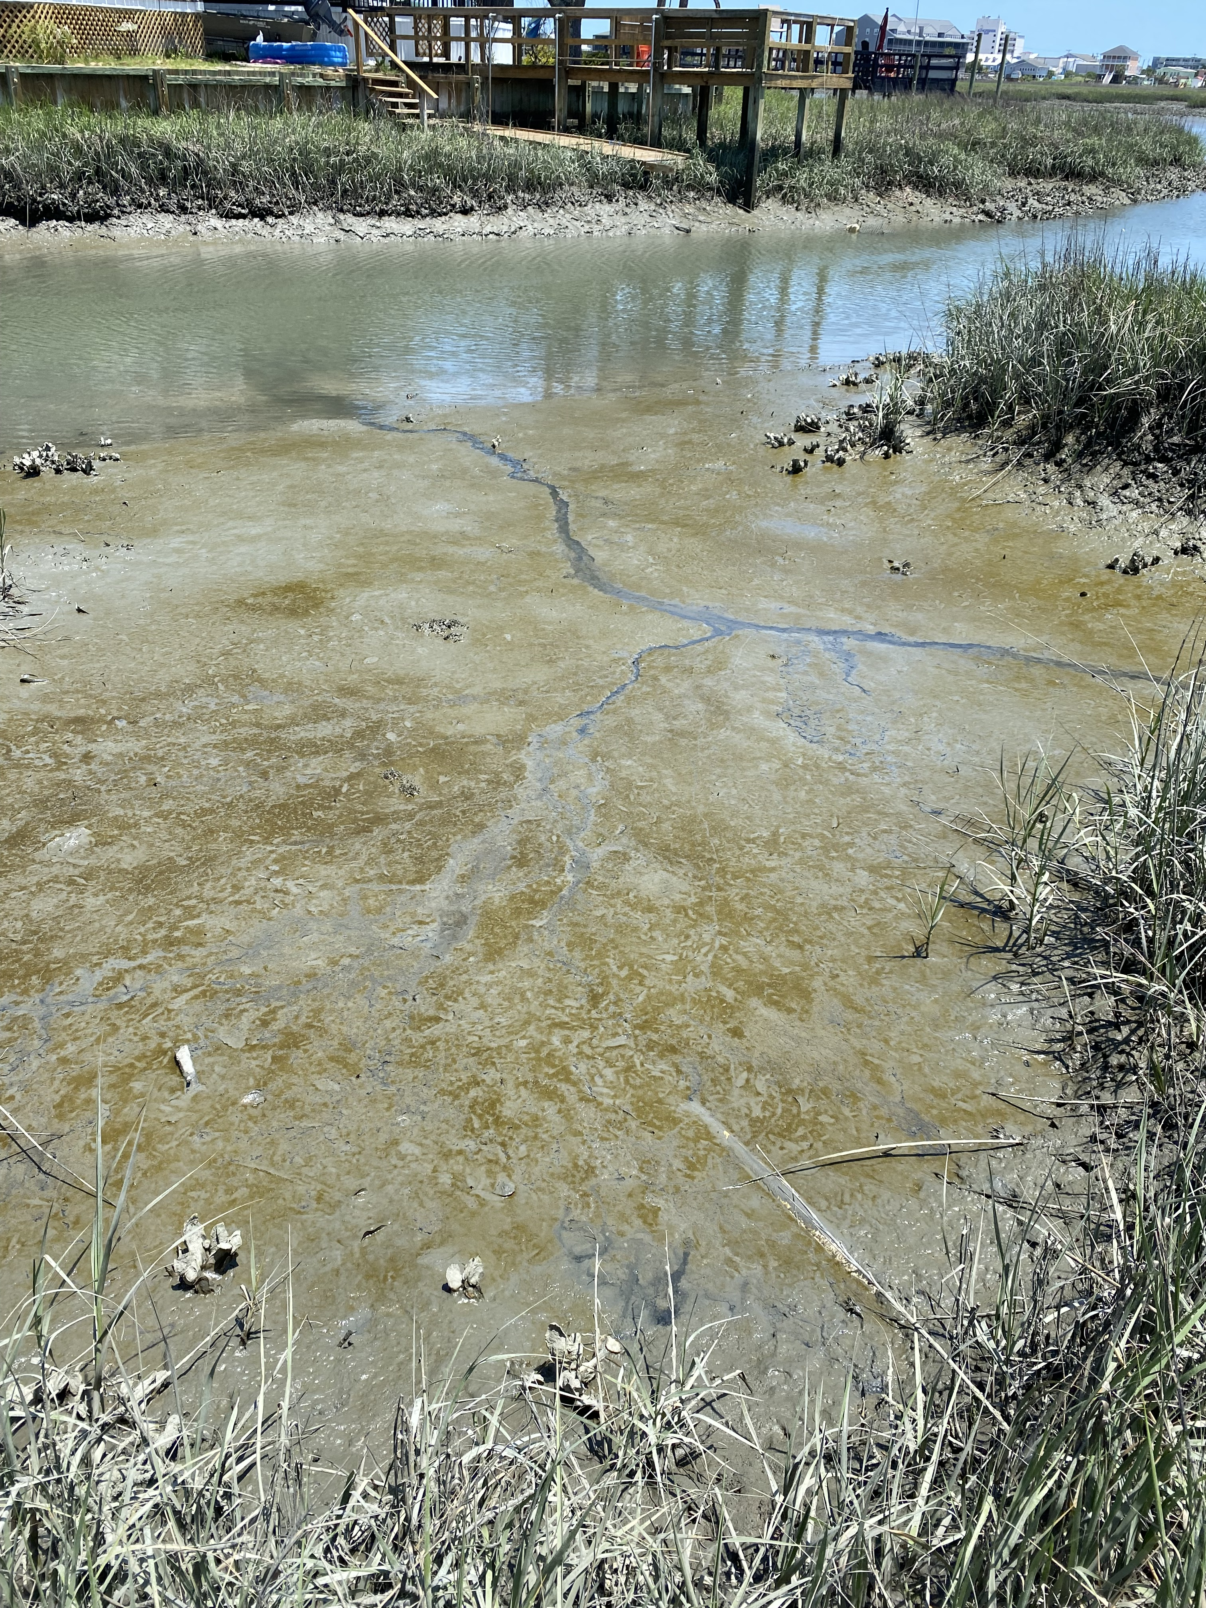
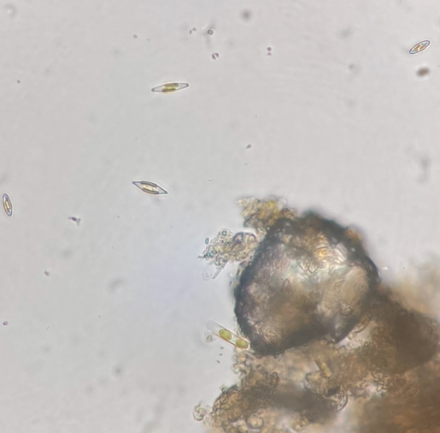

WHAT ARE BENTHIC MICROALGAE?
Bottom dwelling counterparts to phytoplankton
Many of the same taxonomic groups
Diatoms, cyanobacteria, dinoflagellates, green algae, and many others!
Live at and below the sediment surface
Motile and sessile, attached and free living

Slide 3
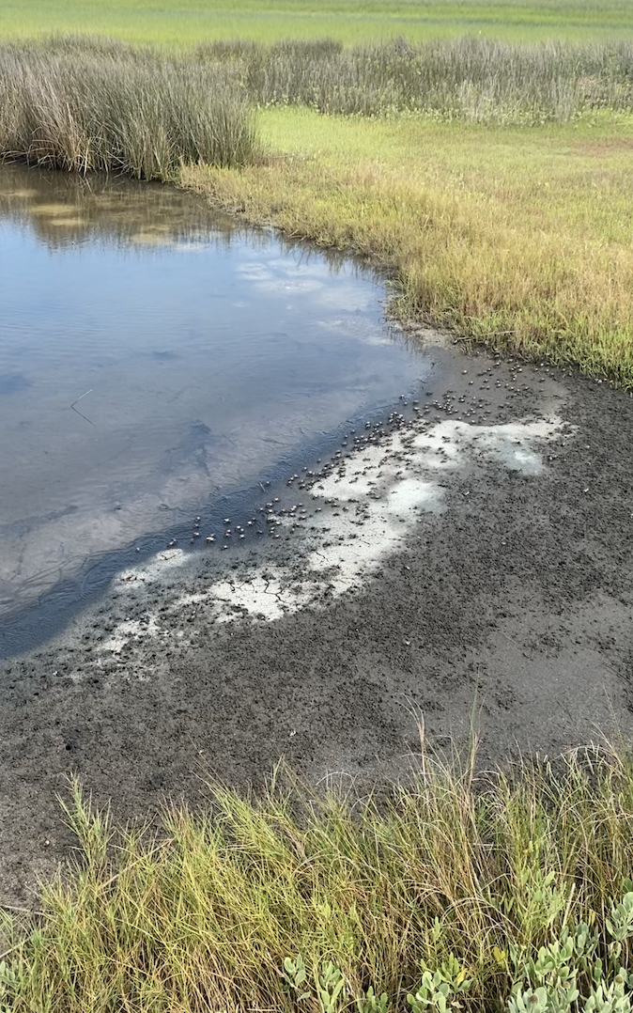
WHY DO WE CARE?
Contribute heavily to nearshore primary productivity
Estimated 30% of NPP in North Inlet, SC
~500 million tons C yr ⁻¹ worldwide
Important food source
Biologically available, unlike many dominant macrophytes (ie Spartina alterniflora)
Sequester carbon through burial (blue carbon)
Ecosystem foundation
But what drives BMA?

Slide 4
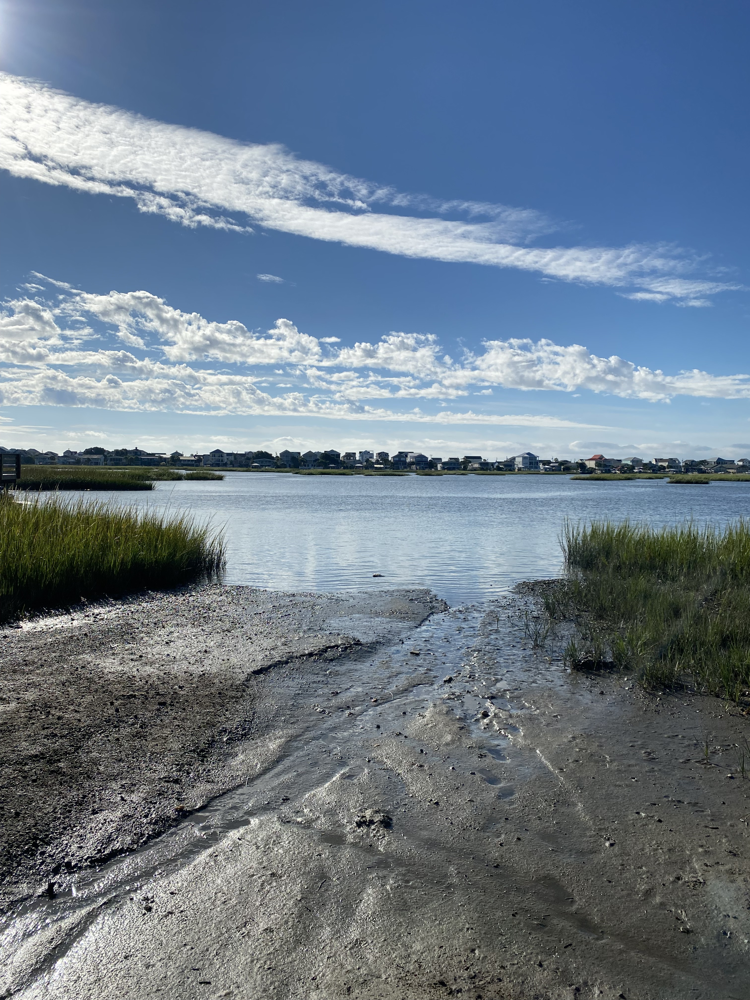
DRIVERS OF BMA
Response to irradiance and heat well understood
Exhibit seasonal fluctuations like other photoautotrophs
Must contend with forcings often unique to the benthos
Sediment composition, porewater chemistry, enhanced shading, desiccation, anoxia
Responses to these abiotic factors far less studied!
Understanding what drives BMA is key to ecosystem function

Slide 5
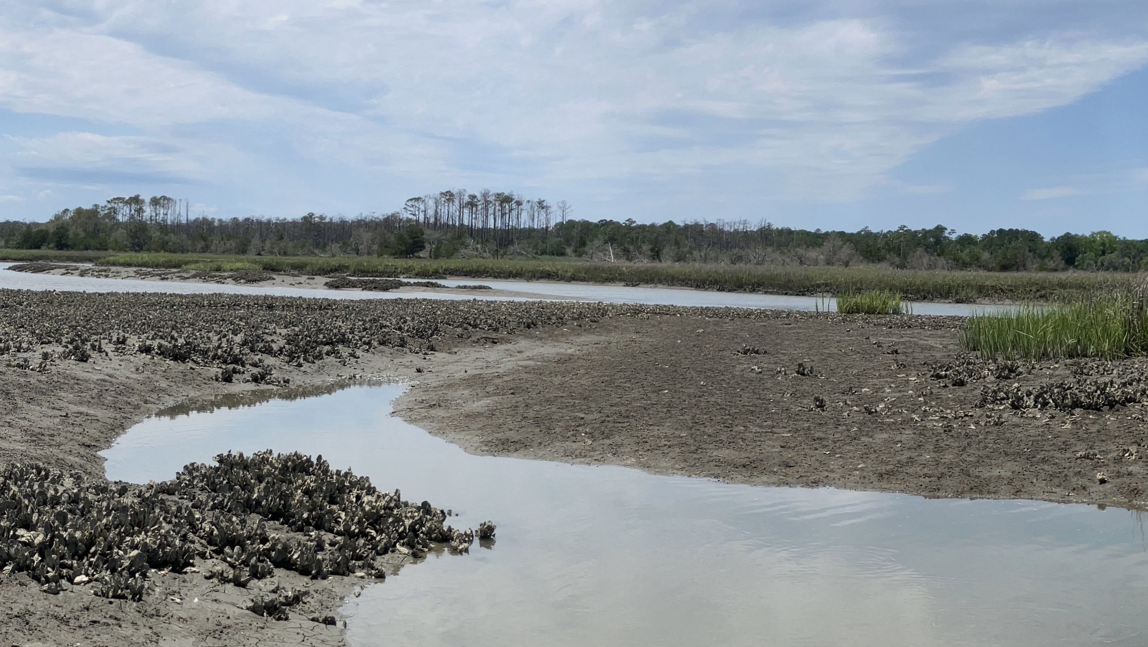
WHAT ARE WE TRYING TO DO?
Determine driving abiotic factors of intertidal BMA biomass
Determine levels of factor response
Increase understanding of how BMA function

Slide 6
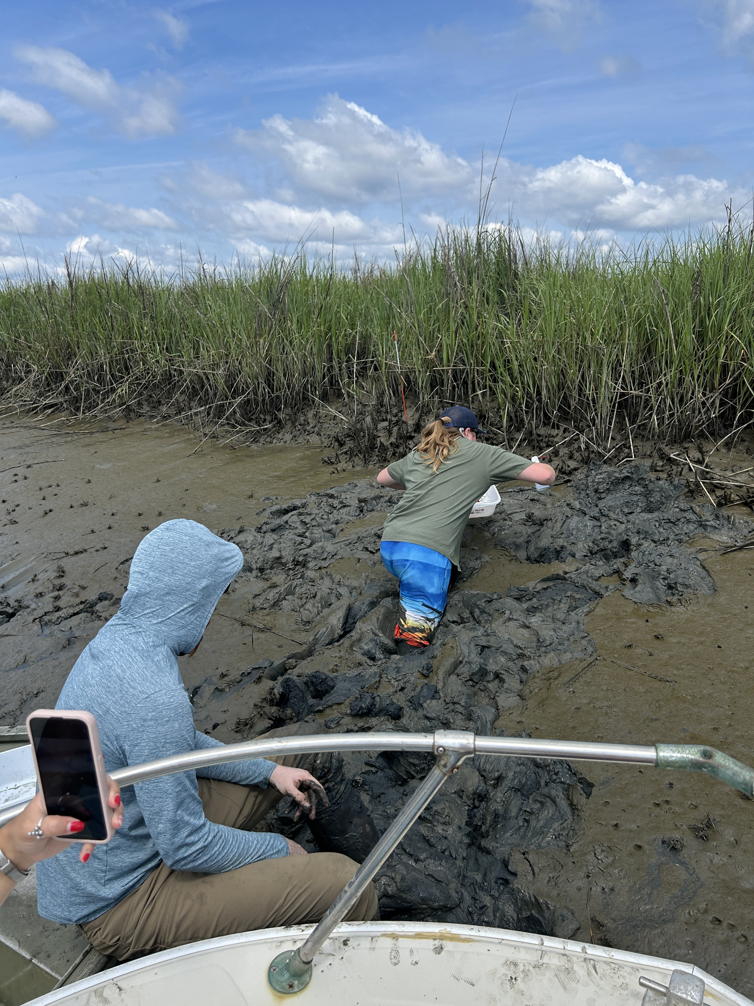
BUT HOW?
Biomass as BMA response variable
Chl a fluorescence proxy
DIN (NO₃ + NH₄) and PO₄ for porewater chemistry
Spectrophotometric methods
Percent composition for grain assemblages
Wet + dry sieving
Sand, silt, clay

Slide 7
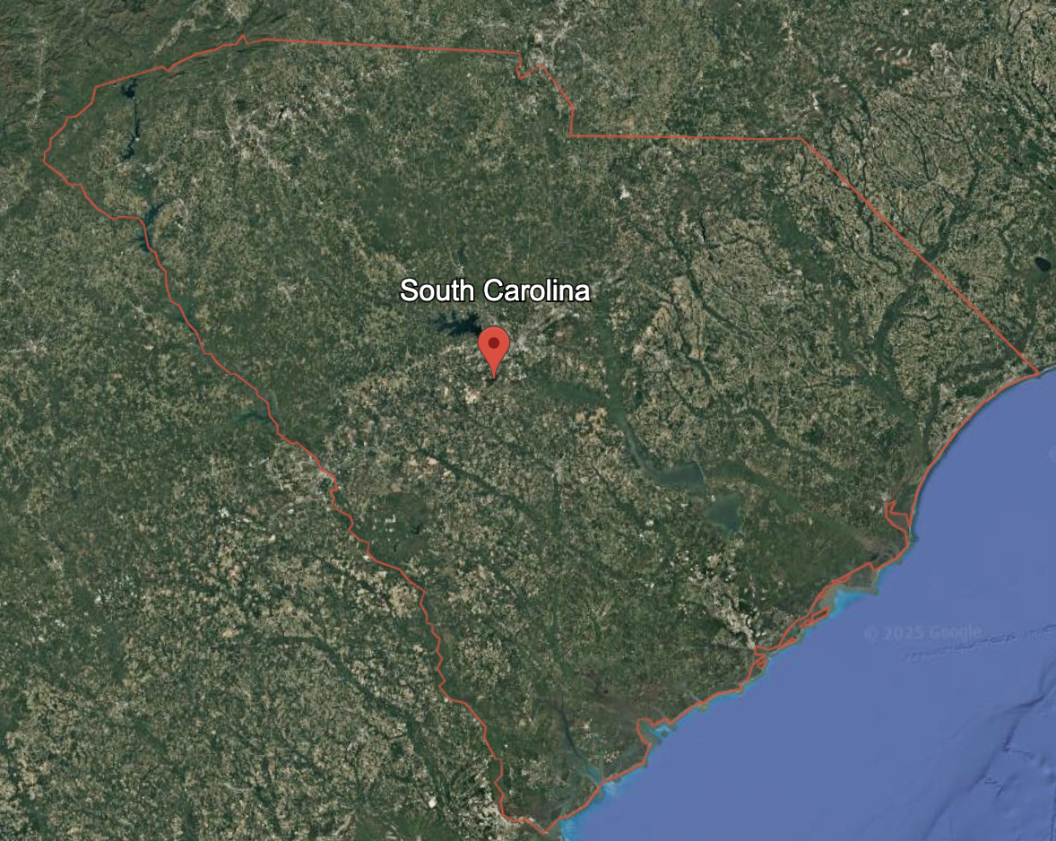

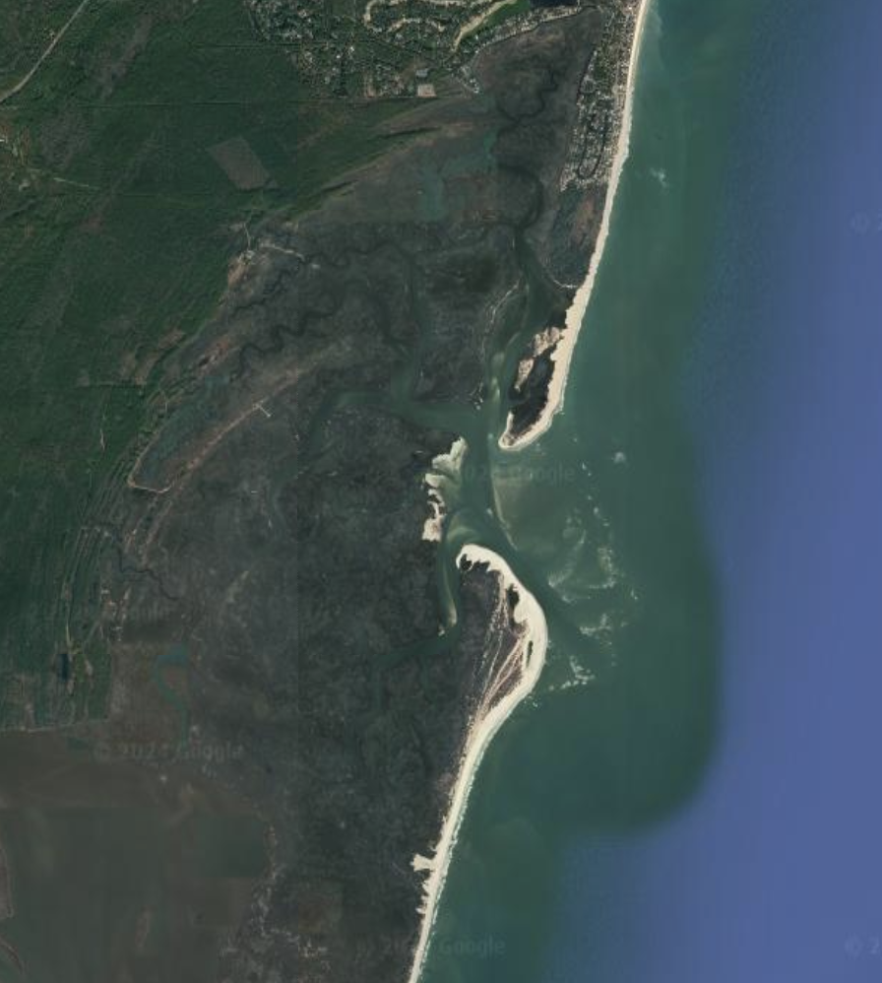

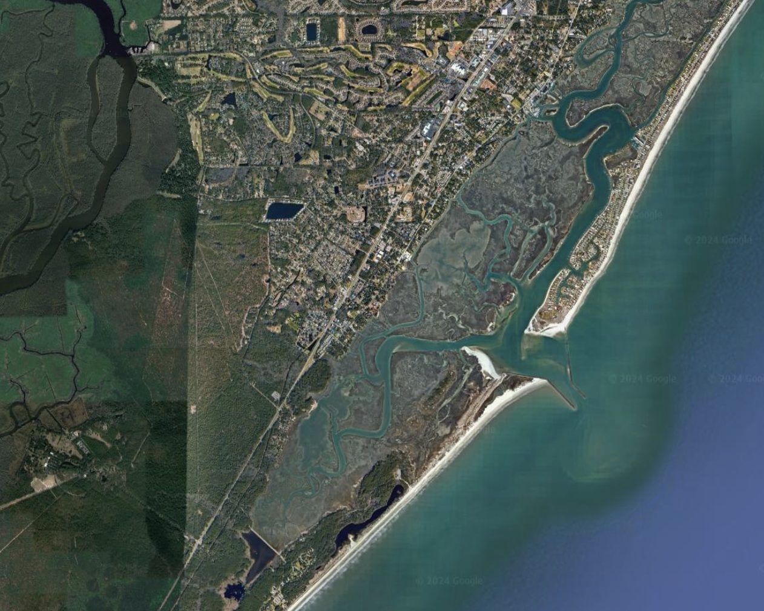

WHERE IN THE WORLD?
Variety of sites between two SC estuaries
Larger range in environmental conditions
Heavily urbanized vs preserve (NERR)
Intertidal mudflats
MLW (± 1m)
Unvegetated
Monthly over the summer of 2025
Peak growing season
Google Earth, 2025
BMFL
North Inlet
Murrells Inlet

Slide 8
RESULTS
[PO₄ ] typically higher at MI
[DIN] similar between estuaries

Slide 9
RESULTS
[Chl a] Not significantly different between estuaries
Larger grain assemblages at MI
*
*
NS

Slide 10
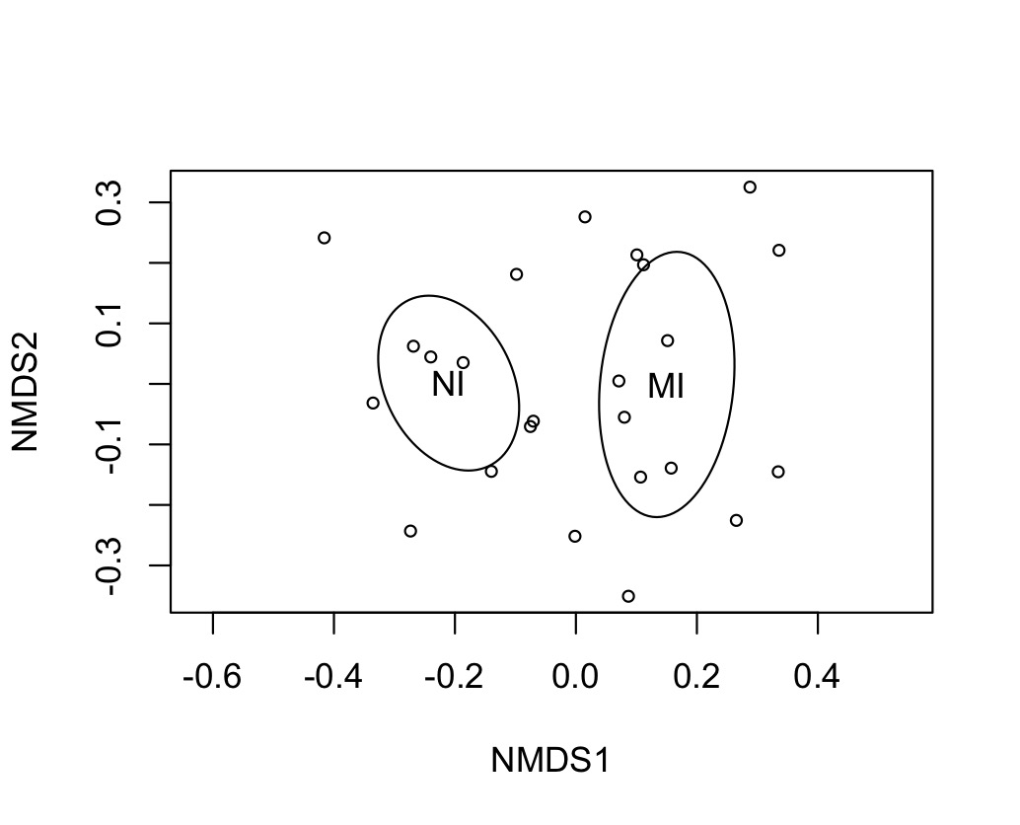
RESULTS
PERMANOVA to determine site differences (MI vs NI)
Chl a + abiotic parameters
Month as blocking factor
p = 0.047
NMDS visualization
stress = 0.141996

Slide 11
RESULTS
Stepwise multiple linear regression
Dependent: [Chl a]
Independent: [DIN], [PO₄], Sediment % composition (sand, silt, clay)
Best predictors: clay, PO₄, sand
p < 0.001
adjusted r² = 0.637

Slide 12
SUMMARY
BMA provide critical ecosystem services
North Inlet and Murrells Inlet provide unique conditions for BMA
Many environmental variables that BMA must contend with
% Sand, % clay, and [PO₄] explain 63.7% of the observed variations in BMA biomass
Other factors may explain remaining variation
Future studies?

Slide 13
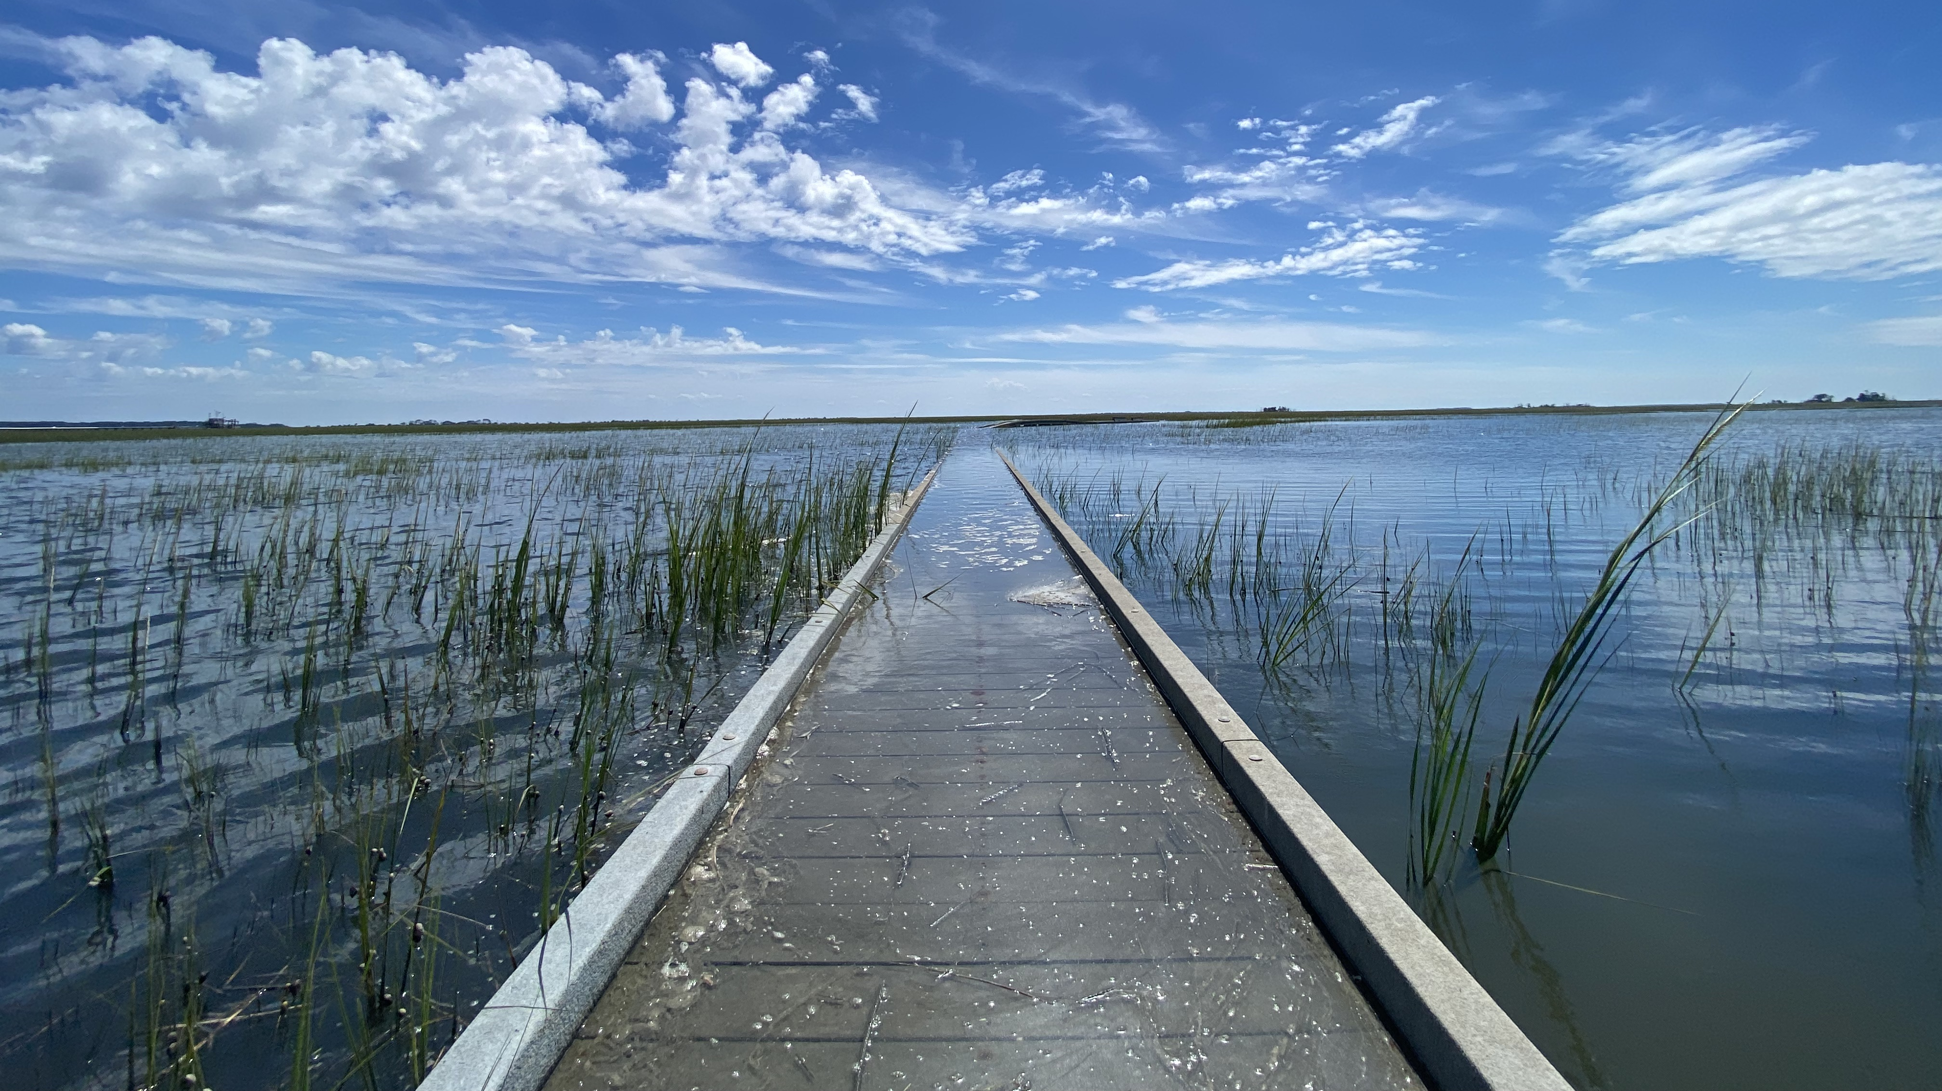

ACKNOWLEDGEMENTS
Funding Sources
Special thanks
Dr Jay Pinckney
Dr. Angelos Hannides
Dr. Annie Bourbonnais
Essence Tornabene
Gavin Madgett
Camille Michaud
Shannon Powers
Cat Schlenker
Jared Rose
Grace Margulies
The rest of the EEL lab elvers!

